Slide 1

COM410 Programming in Practice
Searching

Slide 2
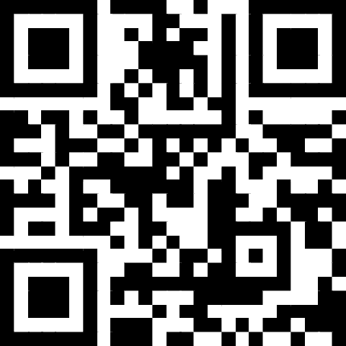
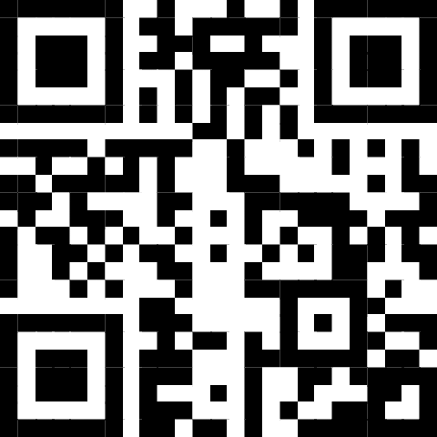
Reach Out
Email:
serif.salem@qa.com
Serif Refined Material (Password: COM410)
https://tinyurl.com/QACOM410
University Drop Box
https://tinyurl.com/QAULSTER

Slide 3
Searching

Slide 4
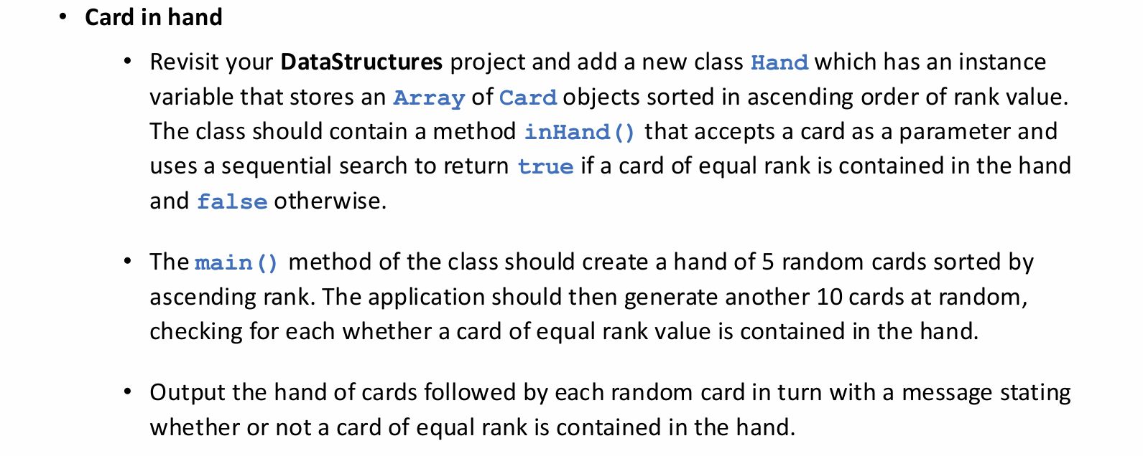
Scenario (Lab)

Slide 5
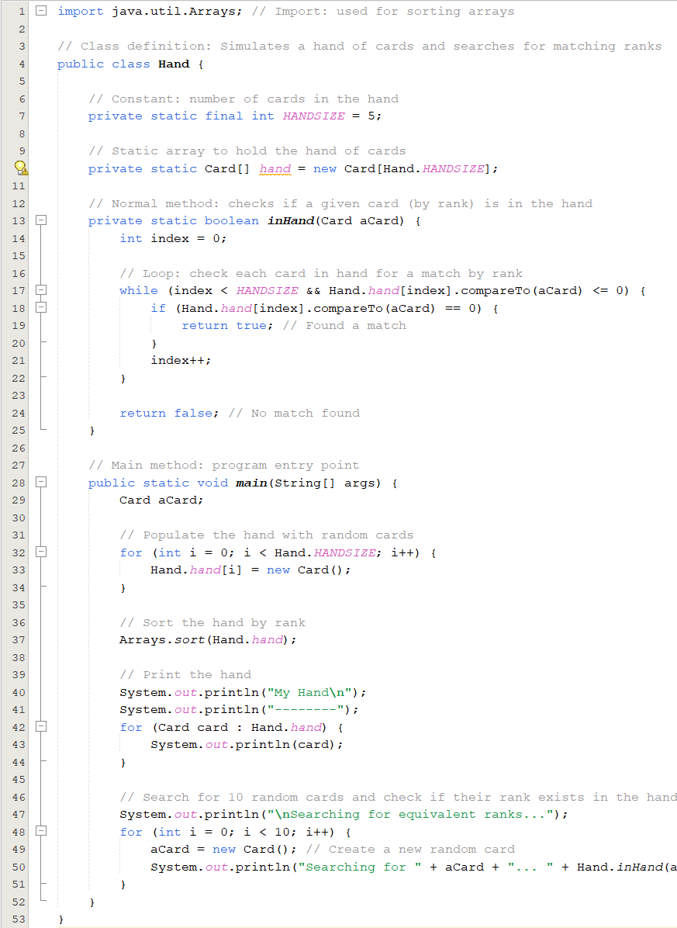
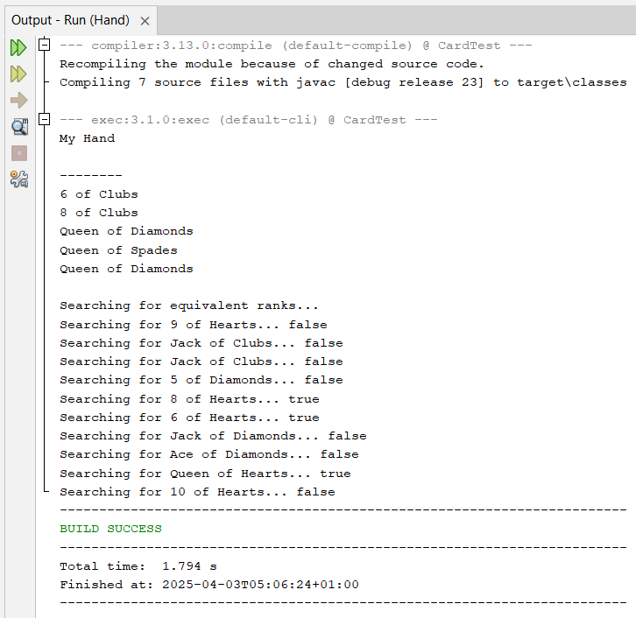

Slide 6
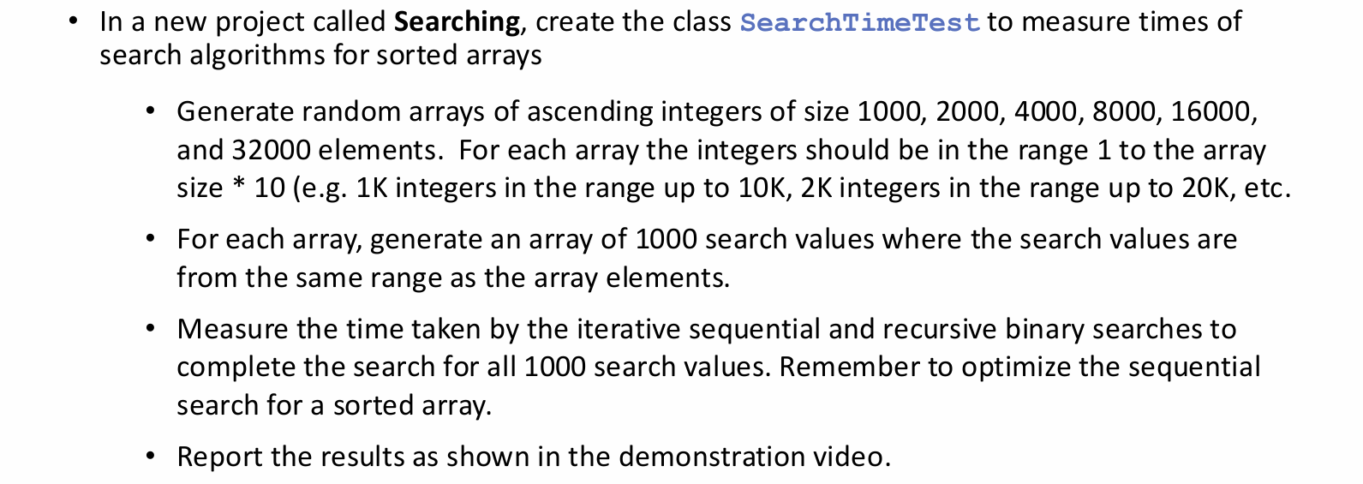
Challenge (Self Practice)

Slide 7
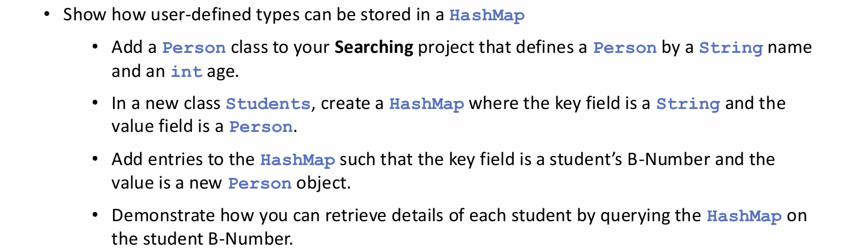
Scenario

